Slide 1
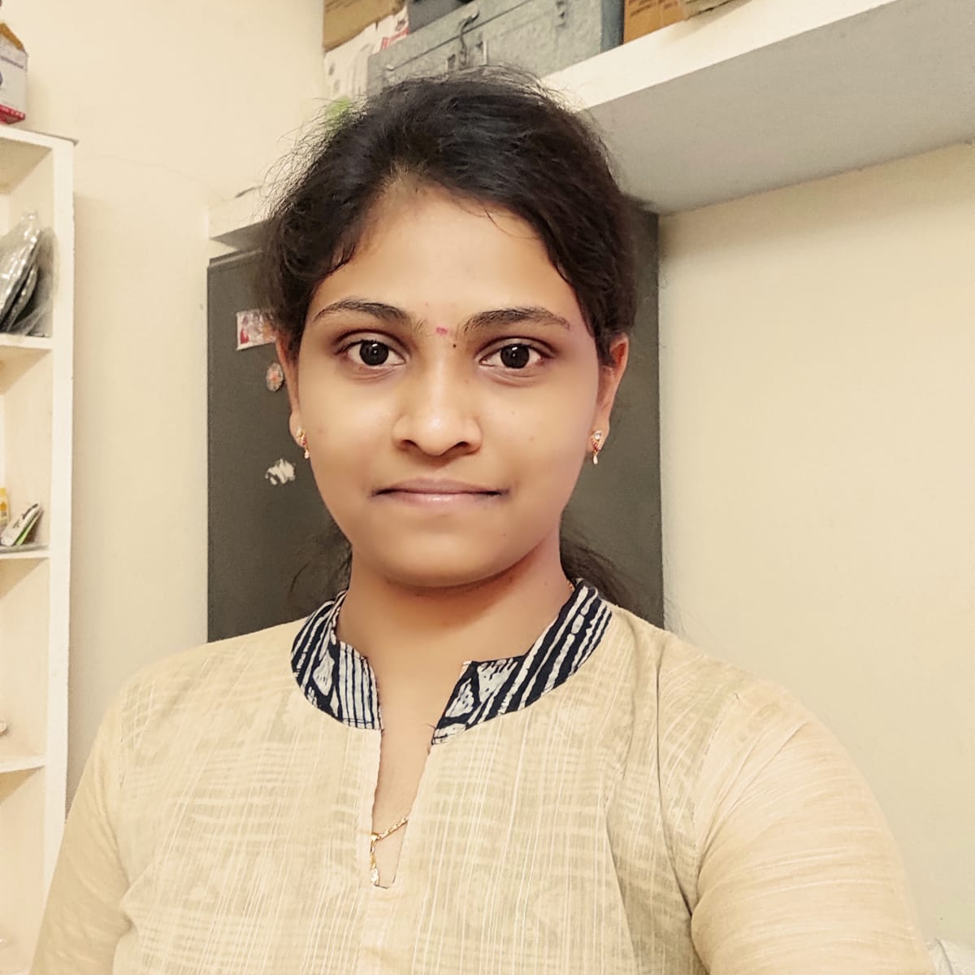

Sindhupriya Kona
Analyst/Software Engineer
Bachelor of Technology
Computer Science Engineering:
2017 – 2021
Skills JAVA 8
Spring Boot
Spring MVC
Bootstrap
Angular
Database:
SQL database-MySQL
Postgres SQL
Web Technologies
HTML5
CSS3
TypeScript
JavaScript
Additional Details:
Leadership
Peer Learning
Team management
AddOns:
GitHub
Postman
Bangalore
sindhupriya.kona@capgemini.com
+91 9160960185
A4
A self driven learner with Front-End and Back-End knowledge. Passionate about implementing and launching new projects.
Hands on experience in creating Web Application with Spring Boot , Rest Controller , JPA with Hibernate and Angular.
Practical Understanding of Query Language Like Postgres SQL, My SQL.
Ready to learn new technologies/Frameworks and implement them to further improve my knowledge.
Eager to work in a team of dedicated people and serve a key role in the enhancement and development of the project.
Implemented Web API and Angular in case study and up skilling this knowledge continuously.
Electricity Bill Payment Application:
Completed end to end case study of Electricity Bill Payment Application along with Validations, Swagger and Angular used for user interface with Postgres as Database.
SENTIMENT ANALYSIS OF BILLING IN ELECTRICITY BILL PAYMENT APPLICATION:
Online electricity bill payment application is a self service facility for view and pay bill online and other related services.
User needs to signup and need to fill up the Customer detail form
Apply for new electricity connection and needs to upload the details of meter.
Bill will be generated based on the reading submitted by customer, then customer view and pay bill.

